Slide 1

System Administration-CSNW3203-ITNT403
Chapter 6: Working with Shell Scripting & Cron Service
Understanding Common Environment Variables
Using Aliases
Writing a shell Script and Run
Using Commands in Shell Scripts
Using Variables in Shell Scripts
Using Conditional Expressions
Using Loops
Understanding the Role of cron
Creating System Cron Jobs

Slide 2
Understanding Command-Line Basics
Understanding Common Environment Variables in Linux Environment variables in Linux are dynamic values that affect the behavior of processes and system applications. These variables store system settings, user preferences, and configuration data, making them essential for managing the system efficiently.
Common Environment Variables in Linux:
PATH – Specifies directories where executable files are located, allowing users to run commands without specifying full paths.
Example: echo $PATH
HOME – Represents the home directory of the current user.
Example: echo $HOME
USER – Displays the currently logged-in user.
Example: echo $USER
SHELL – Defines the default shell used by the user (e.g., Bash).
Example: echo $SHELL
PWD – Shows the present working directory. Note: # is used to write comments. Anything after # on a line is
ignored by the shell.
Example: echo $PWD
Navigate to a subdirectory without specifying full path mkdir project;cd $PWD/project
Copy a file to the current directory
cp /etc/passwd $PWD
Lab: Shell Script named as env.sh in your home directory using Environment Variables # Displaying system environment variables echo "Current User: $USER" echo "Home Directory: $HOME" echo "Shell Type: $SHELL" echo "Current Working Directory: $PWD“

Slide 3
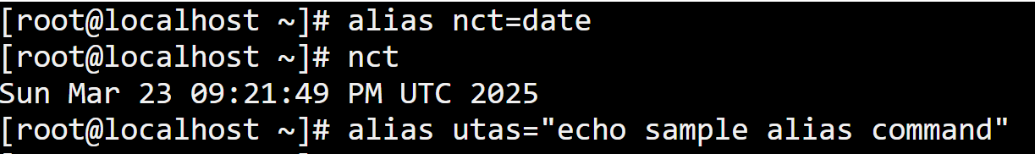
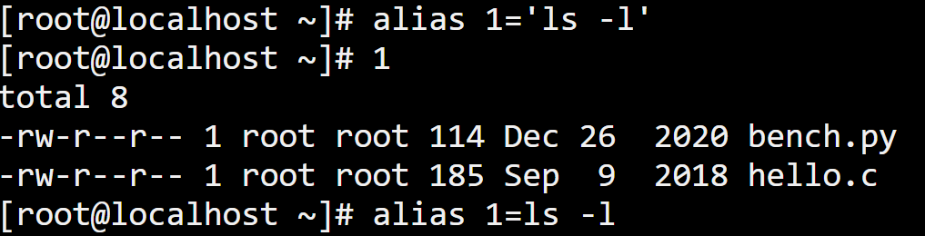
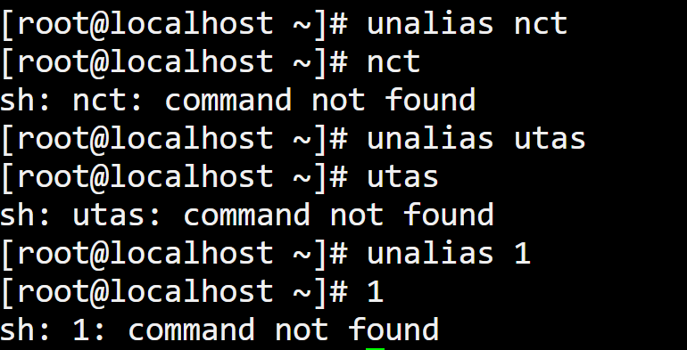
Using Aliases in Linux
Aliases in Linux allow users to create shortcuts for frequently used commands, making the command-line experience more efficient and user-friendly.
1. What is an Alias?
An alias is a custom shortcut that replaces a long or complex command with a simpler keyword.
2. Creating an Alias: use alias command
date command assigned to variable nct and typing nct will execute date command.
echo command assigned to variable utas and typing utas will execute echo command.
ls -l command assigned to variable 1 and typing 1 will execute ls -l command.
3. Removing an Alias:use the unalias command

Slide 4
Advantages of Using Aliases in Linux
Aliases in Linux provide several benefits that enhance productivity and efficiency when working with the command line.
1. Saves Time and Reduces Typing
Aliases allow users to create shortcuts for frequently used commands.
2. Simplifies Complex Commands
for example, alias update="sudo apt update && sudo apt upgrade"
Running update now executes the full system update command.
3. Reduces Errors
Helps avoid mistakes by replacing risky commands with safer alternatives.
Example:
alias rm="rm -i"
This ensures that every rm command asks for confirmation before deleting files.
4. Improves Efficiency for Frequent Tasks
Developers, system administrators, and regular users can automate repetitive tasks.
Example:
alias mydir="cd /home/user/projects"
Instead of typing the full path, users can simply enter mydir.

Slide 5
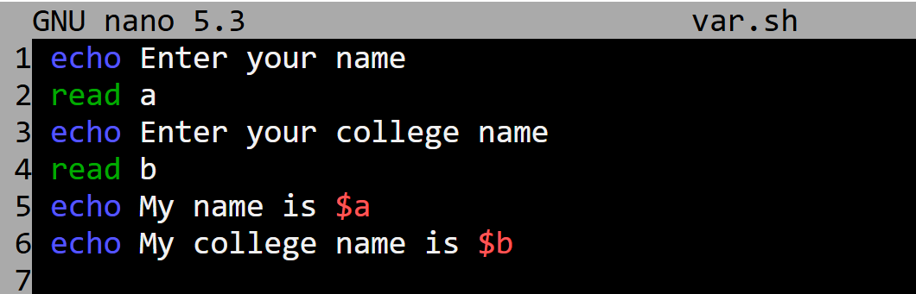
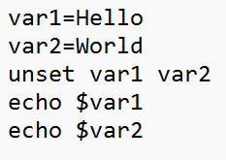
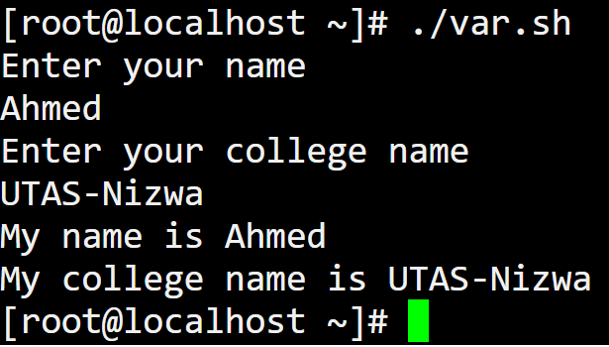
Writing a shell Script and Run
The read command in Linux is used to accept user input from the terminal. It is commonly used in shell scripts for interactive input.
User-Defined Variables in Linux
In Linux, user-defined variables are custom variables created by users in the shell. These variables store values and can be used within scripts or terminal sessions. Use the $ symbol before the variable name to retrieve its value. For example, Assign the value "utas" to the variable nct.
Use the echo command to display the content of the variable nct.
Remove the variable nct using the unset command. The unset command in Linux is used to remove (unset) variables and functions from the shell environment.
[root@localhost ~]# nct=utas Here’s a basic shell script named var.sh that includes
[root@localhost ~]# echo $nct common variable-related commands.
utas
[root@localhost ~]# unset nct
[root@localhost ~]# echo $nct
[root@localhost ~]#
Assign the value "Hello" to the variable var1 and "World" to the variable var2.
Remove the variable var1 and var2 using the unset command.
Use the echo command to display the content of the variable var1 and var2.

Slide 6
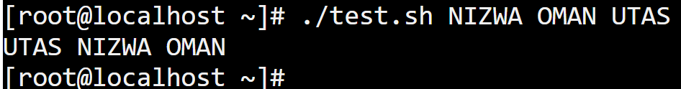
Writing a shell Script and Run
For example, create test.sh shell script as follows:
Assign the value "NIZWA" to the variable $1.
Assign the value "OMAN" to the variable $2.
Assign the value "UTAS" to the variable $3.
echo $3 $1 $2 the order of input arguments.
Lab: Write a shell program to rename one file to another file saved as “copy.sh” using user-defined in your home directory. Note: Create one file using the commands date > d.txt before running the shell script.
Lab: Write a shell program to rename one file to another file saved as “rename.sh” using user-defined variable in your home directory. Note: Create two files using the commands touch nct.txt and touch oman.txt before running the shell script.
echo Enter first file
read a
echo Enter second file
read b
echo Rename $a to $b file
mv $a $b
echo Enter first file
read a
echo Enter second file
read b
echo copy $a to $b file
cp $a $b

Slide 7
Writing a shell Script and Run
For example,
Lab: Shell Script named as string.sh in your home directory to display String Length using user-defined variables.
echo Enter a string
read str
length=${#str}
echo The length of the string is: $length
Note:Here, the # operator is used to get the length of the string variable.
Using Commands in Shell Scripts
Lab: Shell Script named as command.sh in your home directory using commands and environment and user-defined variables.
echo Hello, World
name=Linux User
echo Welcome, $name
echo Display the content of the directory
echo $(ls)
echo Display information about running process
echo $(ps)
echo Display present working directory
echo $PWD
echo Display the current empty files
echo $(find -type f -empty)

Slide 8
Using Conditional Expressions
if command in Linux Shell Scripting
The if statement in Linux shell scripting is used for conditional execution. It checks if a condition is true and executes commands accordingly.
Basic if Statement Syntax
if [ condition ]; then
# Commands to execute if the condition is true
fi
if [ condition ]
then
commands
else
other commands
fi
The condition represented by [ condition ] is more commonly known as the test condition, and it replaces the test command in comparison syntax. fi This marks the end of the if statement
Lab: Write a shell script check If a File Exists in your home directory using if statement. echo "Enter the file name:" read file if [ -f $file ] then echo "File $file exists." else echo "File $file does not exist." fi -f "$file" → Checks if the file exists. If true, it prints that the file exists. Otherwise, it prints that the file does not exist
Lab: Write a shell script check If a directory Exists in your home directory using if statement. echo "Enter the directory name:" read dir if [ -d $dir ] then echo "Directory $dir exists." else echo "Directory $dir does not exist." fi -d "$dir" → Checks if a directory exists.

Slide 9
while do command in Linux Shell Scripting
The while do loop in Linux executes a block of commands repeatedly as long as the specified condition is true.
Syntax
while [ condition ]; do
# Commands to execute
Done
Lab: Write a shell script in Linux to append a new line to an new file or existing file using a while do loop. echo Enter the file name read file echo Enter the content into the file $file while read line do echo $line >> $file done echo Display the content of file $file cat $file

Slide 10
for commad in Linux Shell Scripting
The for loop operates on lists of items. It repeats a set of commands for every item in a list.
Syntax
for var in word1 word2 ... wordN
do
Statement(s) to be executed for every word.
done
Here var is the name of a variable and word1 to wordN are sequences of characters separated by spaces (words).
Each time the for loop executes, the value of the variable var is set to the next word in the list of words, word1 to wordN.
Lab: Write a shell script to display all the files ending with .txt using for loop and available in your home directory. for FILE in $HOME/*.txt do echo $FILE done

Slide 11
case command in Linux Shell Scripting
The case command in Linux is an essential tool. It offers a more readable and efficient way to execute commands based on pattern matching,
making your shell scripts easier to maintain and understand.
Syntax
case WORD in [PATTERN [| PATTERN]...) COMMANDS ;;]... esac
where,
WORD: The variable or value that you want to match against different patterns.
PATTERN: One or more patterns to compare against the WORD. Each pattern is followed by commands to execute if the pattern matches.
COMMANDS: The commands to run when a specific pattern matches the WORD.
;; Ends the command block for each pattern.
esac This marks the end of the case statement (it’s case spelled backward)
Lab:Write a shell script named "my.sh" in your home directory to perform operations using environment variables with a case statement. The script should provide the following options: 1. Display the current date and time. 2. Show logged-in users. 3. Exit. echo "Choose an option:" echo "1. Display current date and time" echo "2. Show logged-in users" echo "4. Exit" echo "Enter your choice“ read choice case $choice in 1) echo "Current date and time: $(date)" ;; 2) echo "Logged-in users:" who ;; 3) echo "Exiting..." exit 0 ;; *) echo "Invalid choice! Please enter a number between 1 and 4." ;; esac

Slide 12
Understanding the Role of cron
Creating System Cron Jobs
Cron is a time-based job scheduler. It allows users to schedule jobs (commands or scripts) to run at specific times or intervals automatically. The cron table or crontab configuration file is /etc/crontab by default. Only system administrators can edit the system crontab file. Display the content of crontab configuration file is cat /etc/crontab.
Cron is widely used for:
1. Automating System Maintenance Tasks
Running backups
Clearing logs
Updating software packages
2. Scheduling User Tasks
Sending email reminders
Running custom scripts
3. Managing Server Operations
Restarting services
Monitoring system health
Running cleanup tasks

Slide 13
Managing Cron Jobs
View Cron Jobs-List current user’s cron jobs:
crontab -l
The crontab -l command is used to list all cron jobs for the current user. It helps users check their scheduled tasks without modifying them.
Edit Cron Jobs-Open the crontab for editing:
crontab -e
The default editor (usually vi or nano) will open the user's crontab. The crontab -e command is used to edit the current user's crontab file and schedule cron jobs. This opens the crontab file in the default text editor, allowing users to add, modify, or delete scheduled tasks.
Delete Cron jobs
The crontab -r command is used to remove all scheduled cron jobs for the current user. Be careful when using this command, as it deletes the entire crontab file without confirmation.

Slide 14
Cron Syntax
Just as it is with any language, working with cron is a lot easier when you understand its syntax and format you should know:
A B C D E /root/backup.sh
* * * * * CMD
MIN HOUR DOM MON DOW COMMAND
Field Allowed Values
MIN (Minutes) 0-59
HOUR 0-23
DOM (Day of Month) 1-31
MON (Month) 1-12 or JAN-DEC
DOW (Day of Week) 0-7 (0 and 7 ) or SUN-SAT
COMMAND The script/command to execute
Cron uses operator symbols which allow you to specify multiple values in a field:
1. Asterisk (*): specifies all possible values for a field
2. The comma (,): specifies a list of values
3. Dash (-): specifies a range of values
4. Separator (/): specifies a step value

Slide 15
Cron job example
For example,
Once inside the crontab file, you can add cron jobs using the format:
Backup Files Every Day at 2 AM
This cron job runs a script that performs backups /home/user/backup.sh at 2 AM daily.
0 2 * * * /home/user/backup.sh
0 2 * * * → Runs at 2:00 AM every day.
/home/user/backup.sh → Path to the backup script.
Run a Script Every 15 Minutes
To check system status or run a regular script /home/user/status.sh every 15 minutes, use:
*/15 * * * * /home/user/status.sh
*/15 * * * * → Runs every 15 minutes.
/home/user/status.sh → Path to the backup script.
Runs /home/user/backup.sh every day at 2:30 AM.
30 2 * * * /home/user/backup.sh

Slide 16
Cron job example
Run /home/user/script.sh at 4:30 PM on the second of every month.
30 16 2 * * /home/user/script.sh
Run /home/user/myscript.sh every day at midnight.
0 0 * * * /home/user/myscript.sh
Run /home/user/monitor.sh every 10 minutes
*/10 * * * * /home/user/monitor.sh
Restart Debian-based Linux distributions Apache Web Server Every Day at 3:00 AM
0 3 * * * apt-get restart apache2
Clean Temporary Files Every Sunday at Midnight
This cron job deletes temporary files every Sunday at midnight:
0 0 * * 0 rm -rf /tmp/* OR 0 0 * * sun rm -rf /tmp/*
0 0 * * 0 → Runs at midnight on Sundays.
rm -rf /tmp/* → Command to delete temporary files.

Slide 17
Chapter 7: Managing Partitions and File System (Creating, Mounting, Unmounting, Disk Quota, File Permission and Ownership)
Understand the different File System
Understand the different Partition Types
Creating File System
Mounting and Unmounting File System
Understating File Permissions and Modes
Changing File Permission using different modes
Changing File Ownership
Understanding Disk Quota
Configuring Disk Quota

Slide 18
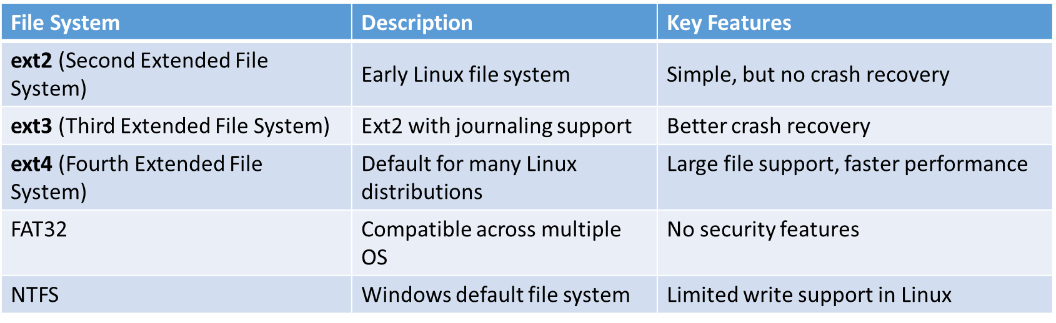
Understand the different File System
A file system in Linux is a method used to store, organize, and manage data on storage devices such as hard drives, SSDs, and USBs. Different file systems offer various features, performance optimizations, and compatibility.
What is a File System?
A file system provides a structured way to store and retrieve files on a disk. It defines: ✅ How data is stored ✅ How files are named and accessed ✅ How permissions and security are managed
Common Linux File Systems
Checking File System Type in Linux
To check the file system of a partition, use command:
df -T

Slide 19
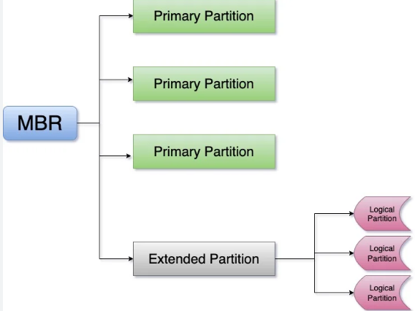
Understand the different Partition Types
A partition is a logical division of a storage device that helps in organizing data efficiently. Linux supports multiple partition types, each serving different purposes based on system requirements.
What is a Partition?
A partition is a section of a hard drive or SSD that is treated as a separate storage unit. Partitions allow you to: ✅ Organize files and operating systems separately ✅ Improve performance and security ✅ Manage multiple file systems on the same disk
Types of Partitions in Linux
Primary Partition
Main partitions (MBR-Master Boot Record)
Use: Bootable OS or data storage
Extended Partition
A special partition that holds logical partitions
Use: Allows more partitions
Logical Partition
Partitions inside an extended partition
Use: Additional storage partitions
Checking Partition Information in Linux
To check partitions on your system, use the following commands:
View detailed partition info with fdisk : sudo fdisk -l
Check partitions with parted : sudo parted -l

Slide 20
Creating File System
Step1: Identify Available Disks and Partitions
Before creating a file system, check available storage devices using following commands.
🔹 List available disks and partitions: lsblk
🔹 Check detailed partition info: sudo fdisk -l
🔹 Identify file system type: df –T
Step 2: Partition the Disk (If Needed)
If the disk has no partition, create one using command fdisk.
Open the disk for partitioning: sudo fdisk /dev/sdb
Verify the new partition: lsblk
Step 3: Create a File System
Once the partition is ready, format it with the required file system.
🔹Format with ext4 (recommended for Linux):sudo mkfs.ext4 /dev/sdb1
Step 4: Mount the File System
To use the file system, it must be mounted to a directory.
🔹 Create a mount point: sudo mkdir /mnt/newdisk
🔹 Mount the partition: sudo mount /dev/sdb1 /mnt/newdisk
🔹 Check mounted file systems:df –h
Step 5: Unmounting a File System
Before unmounting, ensure no files are in use from the mounted partition.
Unmount a file system : sudo umount /mnt/mydrive
Verify unmounting: df -h

Slide 21
Understating File Permissions and Modes
File Permission Basics
Each file in Linux has three types of users:
🔹 Owner (User) – The user who created the file.
🔹 Group – A set of users who share access to the file.
🔹 Others (World) – All other users on the system.
To check permissions, use: ls -l
Example output:
-rw-r--r-- 1 user group 1234 Mar 20 12:00 file.txt
🔹 -rw-r--r-- represents permissions
Read r
Write w
Execute x
For example, -rw-r--r-- means:
rw- (Owner) → Read & Write only
r-- (Group) → Read only
r-- (Others) → Read only
🔹 user is the owner
🔹 group is the group
🔹 1234 is the file size in bytes
🔹 Mar 20 12:00 is the modification time
🔹 file.txt is the file name

Slide 22
Changing File Permission using different modes
There are two modes: symbolic mode and Numeric Mode
Changing Permissions Using Symbolic Mode
In symbolic mode, permissions are modified using:
chmod [user category] [operator] [permissions] filename
Operators:
+ → Adds a permission
- → Removes a permission
= → Sets exact permissions
User Categories:
u → Owner
g → Group
o → Others
a → All (owner, group, others)
Examples:
🔹 Give execute permission to the owner:
chmod u+x file.txt
🔹 Remove write permission from the group:
chmod g-w file.txt
🔹 Grant read access to all users:
chmod a+r file.txt
🔹 Set specific permissions (only read and execute for all users):
chmod a=rx file.txt

Slide 23
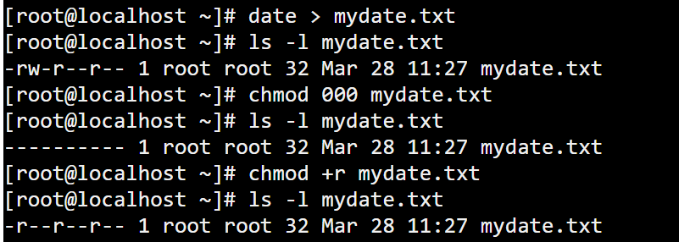
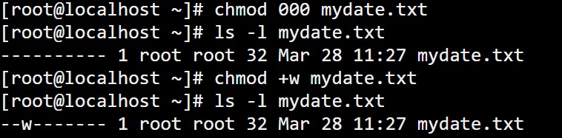
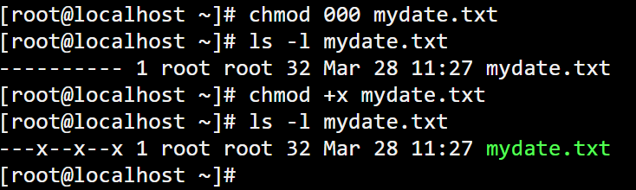
For example,
Redirect date command saved as mydate.txt. Check the file permission of mydate.txt.
Sets no permissions (read, write, or execute) for everyone of mydate.txt file.
Execute the following command:
chmod +r mydate.txt
chmod → Change file permissions
+r → Adds read (r) permission
mydate.txt → Target file
Effect of the Command:
This command grants read permission to all users for the file mydate.txt.
For example,
Sets no permissions (read, write, or execute) for everyone of mydate.txt file.
Execute the following command:
chmod +w mydate.txt
chmod → Change file permissions
+w → Give write(w) permissions only to the owner(user).
mydate.txt → Target file
For example,
Redirect date command saved as mydate.txt. Check the file permission of mydate.txt.
Sets no permissions (read, write, or execute) for everyone of mydate.txt file.
Execute the following command:
chmod +x mydate.txt
chmod → Change file permissions
+x → Adds execute(x) permission
mydate.txt → Target file
Effect of the Command:
This command grants execute permission to all users for the file mydate.txt.

Slide 24
Changing File Ownership
In Linux, file ownership determines who owns a file and which group has access to it. The chown command is used to change file ownership and chgrp command is used to group ownership.
The chown (change owner) command in Linux is used to change the ownership of a file or directory,
Step1: Create user as ahmed, file named as test.txt and view permission of test.txt file.
[root@localhost ~]# useradd ahmed
[root@localhost ~]# cat > test.txt
UTAS Nizwa Oman
[root@localhost ~]#
[root@localhost ~]# ls -l test.txt
-rw-r--r-- 1 root root 16 Mar 28 11:41 test.txt
[root@localhost ~]#
Note: user(owner) name is root
Step2: Change the owner of the test.txt file to ahmed
[root@localhost ~]# chown ahmed test.txt
[root@localhost ~]# ls -l test.txt
-rw-r--r-- 1 ahmed root 16 Mar 28 11:41 test.txt
[root@localhost ~]#

Slide 25
Change the default file and directory permissions
The umask (short for user file-creation mode mask) is a Linux/Unix command and setting that determines the default permissions for newly created files and directories.
The Default permissions of file is 644 rw-r--r--
The Default permission of directory is 755 rwxr-xr-x
How umask Works
When a file or directory is created, it is assigned default permissions. The umask value subtracts from those defaults to determine the final permissions.
Default permissions:
Files: 666 (read and write for owner, group, and others)
Directories: 777 (read, write, and execute for owner, group, and others)
The umask value is subtracted from these defaults.
Understanding umask Values
umask is represented as a three-digit octal number, where:
The first digit applies to the owner.
The second digit applies to the group.
The third digit applies to others.
Each digit works like a "subtracting mask" from the default permissions.

Slide 26
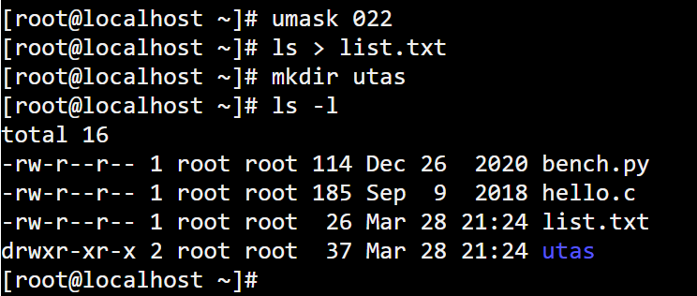
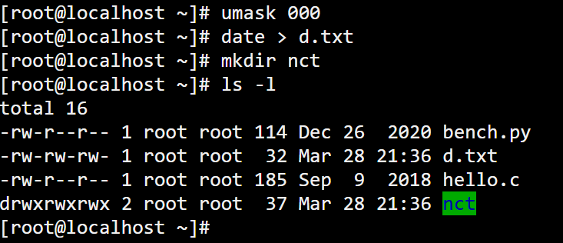
Example Calculations
Example: umask 022
Directory permissions: 777
Final directory permissions: 755 (rwxr-xr-x) (777 – 022 = 755)
File permissions: 666
Final file permissions: 644 (rw-r--r--) (666 – 022 =644)
Viewing and Setting umask
To check the current umask value: umask
Example Calculations
Example: umask 000
Directory permissions: 777
Final directory permissions: 777 (rwxrwxrwx) (777 – 000 = 777)
File permissions: 666
Final file permissions: 666 (rw-rw--rw-) (666 – 000 =666)

Slide 27
Understanding Disk Quota and Configuring Disk Quota
Disk quota is a system administration feature in Linux that allows the administrator to allocate a fixed amount of disk space and file limits to users or groups. This helps prevent any single user or group from consuming excessive disk space, ensuring fair resource allocation.
Why Use Disk Quota?
Prevents a single user from filling up the disk.
Ensures fair usage among multiple users.
Helps in managing and monitoring disk space effectively.
Avoids system failures due to a full disk.
Types of Disk Quotas
Linux supports two types of quotas:
User Quotas – Limits disk usage per individual user.
Group Quotas – Limits disk usage for a group of users.
Installing Quota Package
Before using disk quotas, install the required package:
sudo apt-get update
sudo apt-get install quota quotatool
Assigning Quotas to Users and groups
Set a quota for a user: sudo edquota -u username
Set a quota for a group: sudo edquota -u group
Checking Quota Usage
To check a user’s quota:
quota -u username
To check a group’s quota:
quota -g groupname

